Slide 1




Computer Networks
Communicating Over the Network
Lecturer: Sura F. Ismail
Lecture Two.
Second Class.
Time: 8: 30- 10:30
Department: Informatics Systems Management (ISM)

Slide 2
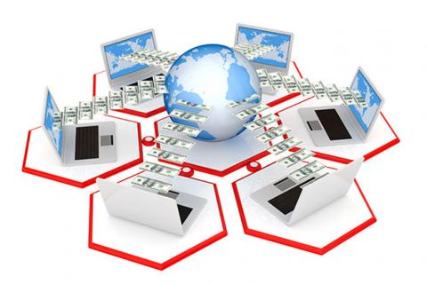
Outline
Outline
Overview
The Platform for Communications
LANs, WANs, and Internetworks
Network Protocols
Using Layered Models
Network Addressing
6. Trends in Networking

Slide 3
1. Overview
Outline
In this lecture, you explore the fundamentals of communication and learn how they apply to communication in and between data networks. You also learn about two important models that describe the process of network communication and the devices used to achieve communication between network hosts.

Slide 4
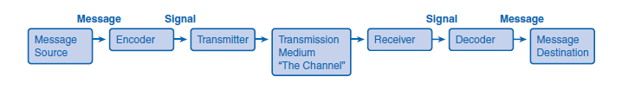
2. The Platform for Communications
Outline
The Elements of Communication
People exchange ideas using many different communication methods. All of these methods have three elements in common:
Message source or sender: Message sources are people, or electronic devices, that need to send a message to other individuals or devices.
Destination or receiver of the message: The destination receives the message and interprets it.
Channel: A channel consists of the media that provides the pathway over which the message can travel from source to destination.

Slide 5
2. The Platform for Communications
Outline
Communicating the Messages
Computer networks carry messages large and small. Devices often exchange updates that are small and require very little bandwidth, yet are very important. Other messages, for example, high-quality photos, can be very large and consume a lot of network resources. Sending a large photograph in one continuous stream of data might mean that a device misses an important update or other communication that will need to be re-sent, using even more bandwidth.
The answer to this problem is a process called segmentation, in which all messages are broken into smaller pieces that can be easily transported together across a medium.

Slide 6
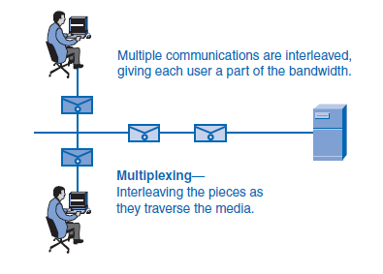
2. The Platform for Communications
Outline
Segmenting messages has two primary benefits:
Multiplexing
Increased efficiency of network communications
Multiplexing occurs when the segments of two or more messages can shuffle into each other and share the medium. Figure below depicts how messages can be broken into smaller pieces and multiplexed onto a single medium.

Slide 7
2. The Platform for Communications
Outline
A second benefit of segmentation is that networks can more efficiently send the message through different routes if necessary. This can happen because the Internet is always adjusting routes for efficiency.
The downside to using segmentation and multiplexing to transmit messages across a network is the level of complexity that is added to the process.
In network communications, each segment of the message must go through a similar process to ensure that it gets to the correct destination and can be reassembled into the content of the original message. Various types of devices throughout the network participate in ensuring that the pieces of the message arrive reliably at their destination.

Slide 8
2. The Platform for Communications
Outline
Components of the Network
The path that a message takes from source to destination can be as simple as a single cable connecting one computer to another or as complex as a network that literally spans the globe.
Devices and media are the physical elements or hardware of the network. Hardware is often the visible components of the network platform such as a laptop, a PC, a switch, or the cabling used to connect the devices.
Services and processes are the communication programs, called software, that run on the networked devices. A network service provides information in response to a request. Services include many of the common network applications people use every day, like e-mail hosting services and web hosting services. Processes provide the functionality that directs and moves the messages through the network.

Slide 9
2. The Platform for Communications
Outline
End Devices and Their Role on the Network
An end device refers to a piece of equipment that is either the source or the destination of a message on a network. Network users usually only see and touch an end device, which is most often a computer. Another generic term for an end device that sends or receives messages is a host. A host can be one of several pieces of equipment performing a wide variety of functions. Examples of hosts and end devices are as follows:
Computers, including workstations, laptops, and servers connected to a network
Network printers
Voice over Internet Protocol (VoIP) phones
Cameras on a network, including webcams and security cameras
Handheld devices such as PDAs and handheld scanners
Remote monitoring stations for weather observation

Slide 10
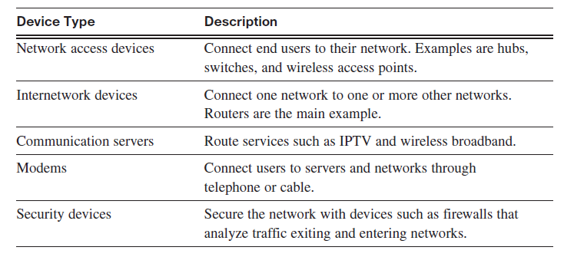
2. The Platform for Communications
Outline
Intermediary Devices and Their Role on the Network
End devices are the hosts that initiate communications and are the ones that people are most familiar with. But getting a message from the source to the destination can be a complex task involving several intermediary devices along the way. Intermediary devices connect the individual hosts to the network and can connect multiple individual networks to form an internetwork. Intermediary devices are not all the same. Some work inside the LAN performing switching functions, and others help route messages between networks.

Slide 11
2. The Platform for Communications
Outline
The management of data as it flows through the network is also a role of the intermediary devices. These devices use the destination host address, in conjunction with information about the network interconnections, to determine the path that messages should take through the network. Processes running on the intermediary network devices perform these functions:
Regenerate and retransmit data signals
Maintain information about what pathways exist through the network and internetwork
Notify other devices of errors and communication failures
Direct data along alternate pathways when there is a link failure
Classify and direct messages according to quality of service (QoS) priorities
Permit or deny the flow of data, based on security settings

Slide 12
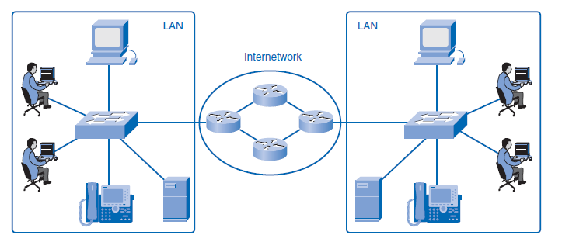
2. The Platform for Communications
Outline

Slide 13
2. The Platform for Communications
Outline
Network Media
Communication across a network is carried on a medium. The medium provides the channel over which the message travels from source to destination. The three main types of media in use in a network are
Copper
Fiber-optic cable
Wireless
Each of these media has vastly different physical properties and uses different methods to encode messages. Encoding messages refers to the way data is converted to patterns of electrical, light, or electromagnetic energy and carried on the medium.

Slide 14
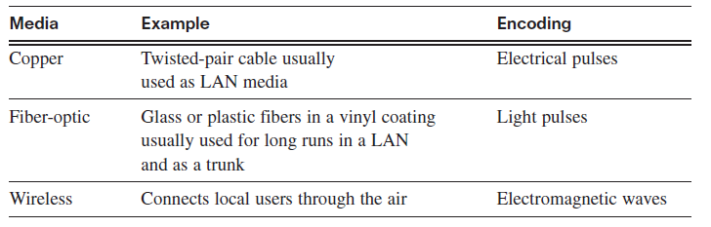
2. The Platform for Communications
Outline
The differences in the media make each one ideal for different roles in networking situations. When choosing network media, administrators must consider the following:
The distance the media can carry the signal
The environment in which the media works
The bandwidth requirements for users
The cost of installation
The cost of connectors and compatible equipment

Slide 15
3. LANs, WANs, and Internetworks
Outline
Networks come in many sizes and serve a wide variety of functions. Following are some of the basic differences:
The size of the area covered
The number of users connected
The number and types of services available
Three distinct groups of networks accommodate different groups and extend geographic boundaries: local-area networks (LANs), wide-area networks (WANs), and internetworks.

Slide 16
3. LANs, WANs, and Internetworks
Outline
Local-Area Networks
A local-area network (LAN) is a group of end devices and users under the control of a common administration. The term local first meant that the computers were grouped geographically close together and had the same purpose in an organization.
Wide-Area Networks
A wide-area network (WAN) is a network that is used to connect LANs that are located geographically far apart. If a company has offices in different cities, it will contract with a telecommunications service provider (TSP) to provide data lines between LANs in each city. The leased lines will vary in service and bandwidth, depending on the terms of the contract.

Slide 17
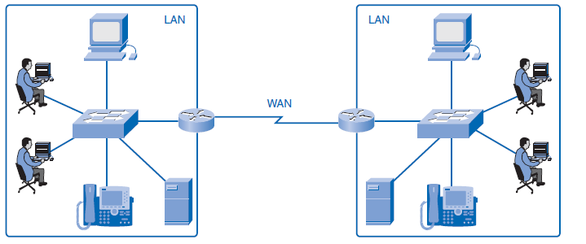
3. LANs, WANs, and Internetworks
Outline

Slide 18
3. LANs, WANs, and Internetworks
Outline
The Internet: A Network of Networks
In years past, LANs changed the way people worked, but they were limited to the resources within each network. Now workers who are not restricted to their own LAN can access other LANs on an internetwork. An internetwork is a collection of two or more LANs connected by WANs. Internetworks are referred to interchangeably as data networks or simply networks. The most popular internetwork is the Internet, which is open to public use. With LANs able to communicate with other LANs using WANs, many organizations developed intranets. A term often confused with the Internet, an intranet is a private web of networks closed to the public but open for employees to browse. For example, many companies use intranets to share company information and training across the globe to far-away employees. Documents are shared and projects are managed securely over great distances on an intranet.

Slide 19
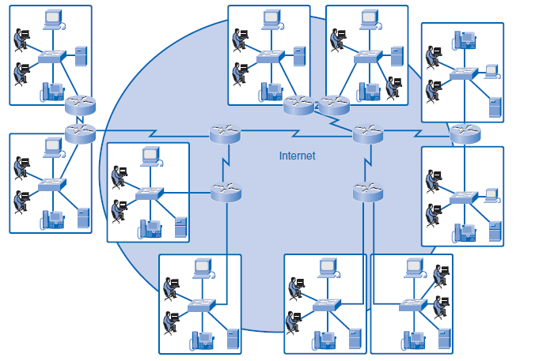
3. LANs, WANs, and Internetworks
Outline
Internet service providers (ISP), which are often also TSPs, connect their customers to the Internet.

Slide 20
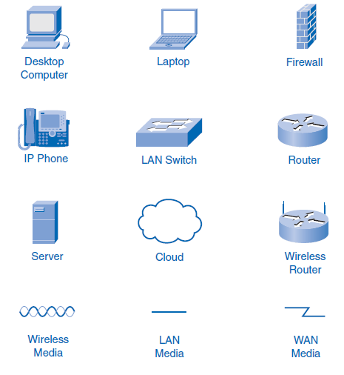
3. LANs, WANs, and Internetworks
Outline
Network Representations
Lecture one, “Living in a Network-Centric World,” introduced many common data network symbols as shown below:

Slide 21
3. LANs, WANs, and Internetworks
Outline
Network Representations
When discussing how devices and media connect to each other, remember these important terms:
Network interface card (NIC): A NIC, or LAN adapter, provides the physical connection to the network at the PC or other host device. The media connecting the PC to the networking device plugs directly into the NIC. Each NIC has a unique physical address that identifies it on the LAN.
Physical port: A physical port is a connector or outlet on a networking device where the media is connected to a host or other networking device. You can assume that all network host devices used in this book have a physical port that allows a connection to the network.
Interface: The term interface refers to how the device can allow two different networks to communicate. Routers connect to different networks, and the specialized NICs on routers are simply called interfaces. The interface on a router device has a unique physical address and appears as a host on the local network.

Slide 22
4. Network Protocols
Outline
For devices to communicate on a network, they must follow different protocols that perform the many tasks to be completed. The protocols define the following:
The format of the message, such as how much data to put into each segment
The way intermediary devices share information about the path to the destination
The method to handle update messages between intermediary devices
The process to initiate and terminate communications between hosts
The authors of the protocols might be writing them for a specific company that will own the protocol. The protocol is treated like a copyright and can be licensed to other companies to use. Protocols controlled by a company and not for public use are considered proprietary. Other protocols are written for public use at no charge and are considered open source protocols.

Slide 23
5. Using Layered Models
Outline
The IT industry uses layered models to describe the complex process of network communication.
The Benefits of a Layered Model
By breaking the network communication process into manageable layers, the industry can benefit in the following ways:
Defines common terms that describe the network functions to those working in the industry and allows greater understanding and cooperation.
Segments the process to allow technologies performing one function to evolve independently of technologies performing other functions.
Fosters competition because products from different vendors can work together.
Provides a common language to describe networking functions and capabilities.
Assists in protocol design, because protocols that operate at a specific layer have defined information that they act upon and a defined interface to the layers above and below.

Slide 24
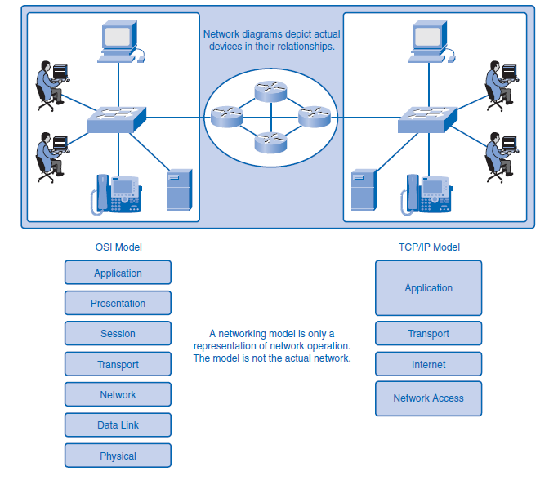
5. Using Layered Models
Outline
Protocol and Reference Models

Slide 25
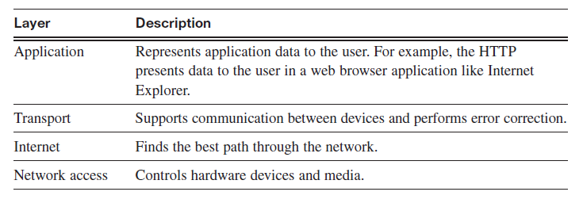
5. Using Layered Models
Outline
TCP/IP Model
The TCP/IP model defines the four communication functions that protocols perform. TCP/IP is an open standard, which means that one company does not control it. The rules and implementations of the TCP/IP model were cooperatively developed by members of the industry using Request for Comments (RFC) documents.

Slide 26
5. Using Layered Models
Outline
Communication Process
The TCP/IP model describes the functionality of the protocols that make up the TCP/IP protocol suite. These protocols, which are implemented on both the sending and receiving hosts, interact to provide end-to-end delivery of applications over a network. A complete communication process includes these steps:
1. Creation of data at the application layer of the originating source end device.
2. Segmentation and encapsulation of data as it passes down the protocol stack in the source end device.
3. Generation of the data onto the media at the network access layer of the stack.

Slide 27
5. Using Layered Models
Outline
Communication Process
4. Transportation of the data through the internetwork, which consists of media and any intermediary devices.
5. Reception of the data at the network access layer of the destination end device.
6. Decapsulation and reassembly of the data as it passes up the stack in the destination device. You learn more about the encapsulation and decapsulation processes in the next section.
7. Passing this data to the destination application at the application layer of the destination end device.

Slide 28
5. Using Layered Models
Outline
Protocol Data Units and Encapsulation
For application data to travel uncorrupted from one host to another, header (or control data), which contains control and addressing information, is added to the data as it moves down the layers. The process of adding control information as it passes through the layered model is called encapsulation.
Decapsulation is the process of removing the extra information and sending only the original application data up to the destination application layer.
Each layer adds control information at each step. The generic term for data at each level is protocol data unit (PDU).

Slide 29
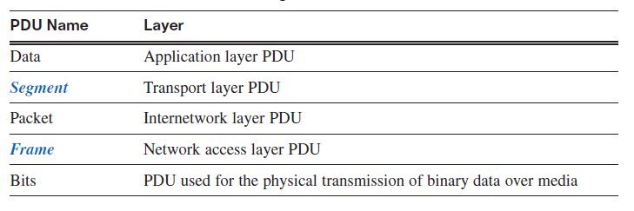
5. Using Layered Models
Outline

Slide 30
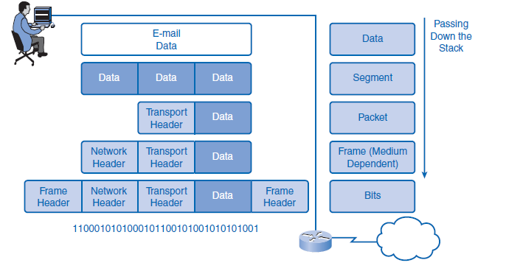
5. Using Layered Models
Outline

Slide 31
5. Using Layered Models
Outline
Sending and Receiving Process
The common task of sending an e-mail has many steps in the process. Using the proper terms for PDUs and the TCP/IP model, the process of sending the e-mail is as follows:
1. An end user, using an e-mail application, creates data. The application layer codes the data as e-mail and sends the data to the transport layer.
2. The message is segmented, or broken into pieces, for transport. The transport layer adds control information in a header so that it can be assigned to the correct process and all segments put into proper order at the destination. The segment is sent down to the internetwork layer.
3. The internetwork layer adds IP addressing information in an IP header. The segment is now an addressed packet that can be handled by routers en route to the destination. The internetwork layer sends the packet down to the network access layer.

Slide 32
5. Using Layered Models
Outline
Sending and Receiving Process
4. The network access layer creates an Ethernet frame with local network physical address information in the header. This enables the packet to get to the local router and out to the web. The frame also contains a trailer with error-checking information. After the frame is created, it is encoded into bits and sent onto the media to the destination.
5. At the destination host, the process is reversed. The frame is decapsulated to a packet, then to a segment, and then the transport layer puts all segments into the proper order.
6. When all data has arrived and is ready, it is sent to the application layer, and then the original application data goes to the receiver’s e-mail application. The message is successful.

Slide 33
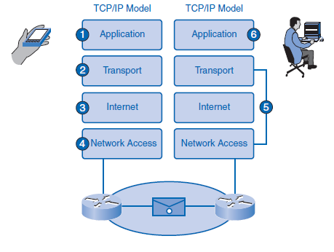
5. Using Layered Models
Outline

Slide 34
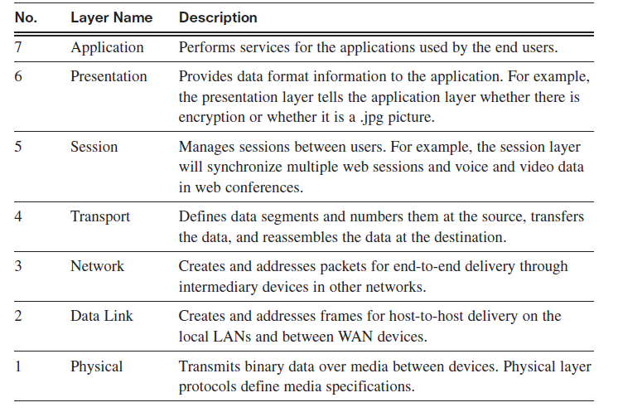
5. Using Layered Models
Outline
OSI Model
The Open Systems Interconnection (OSI) model, known as the OSI model, provides an abstract description of the network communication process. Developed by the International Organization for Standardization (ISO) to provide a road map for nonproprietary protocol development, the OSI model did not evolve as readily as the TCP/IP model.

Slide 35
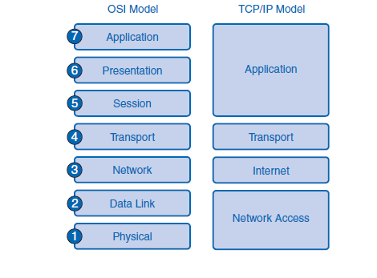
5. Using Layered Models
Outline
Comparing the OSI Model to the TCP/IP Model
The TCP/IP model evolved faster than the OSI model and is now more practical in describing network communication functions. The OSI model describes in detail functions that occur at the upper layers on the hosts, while networking is largely a function of the lower layers.

Slide 36
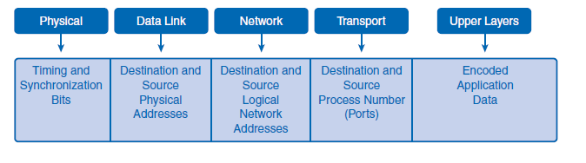
6. Network Addressing
Outline
Successful communication requires that a sender and a receiver know how to get messages to each other. With the Internet, computers can communicate regardless of physical location. Instead of using a geographical addressing scheme for computers, engineers devised a logical addressing scheme using numeric network addresses.
Addressing in the Network
There are millions of computers in use on the web and billions of messages traversing networks at any given time, so proper addressing is essential to make sure that the sent message arrives intact at the proper destination. Addressing of data happens in three different layers of the OSI model. The PDU at each layer adds address information for use by the peer layer at the destination.

Slide 37
6. Network Addressing
Outline
Getting Data to the End Device
During the process of encapsulation, address identifiers are added to the data as it travels down the protocol stack on the source host. There are two layers of addressing added to ensure that data is delivered to the destination.
The first identifier, the host physical address, is contained in the header of the Layer 2 PDU, called a frame. Layer 2 is concerned with the delivery of messages on a single local network.
The Layer 2 address is unique on the local network and represents the address of the end device on the physical media. The physical address comes from codes placed on the NIC by the manufacturer. In a LAN using Ethernet, this address is called the MAC address. The terms physical address and MAC address are often used interchangeably.
When two end devices communicate on the local Ethernet network, the frames that are exchanged between them contain the destination and source MAC addresses.
After a frame is successfully received by the destination host, the Layer 2 address information is removed as the data is decapsulated.

Slide 38
6. Network Addressing
Outline
Getting Data Through the Internetwork
Layer 3 protocols are primarily designed to move data from one local network to another local network within an internetwork. Whereas Layer 2 addresses are only used to communicate between devices on a single local network, Layer 3 addresses must include identifiers that enable intermediary network devices to locate hosts on different networks.
In the TCP/IP protocol suite, every IP host address contains information about the network where the host is located.
At the boundary of each local network, an intermediary network device, usually a router, decapsulates the frame to read the destination host address contained in the header of the packet, the Layer 3 PDU. Routers use the network identifier portion of this address to determine which path to use to reach the destination host. When the path is determined, the router encapsulates the packet in a new frame and sends it on its way toward the destination end device.

Slide 39
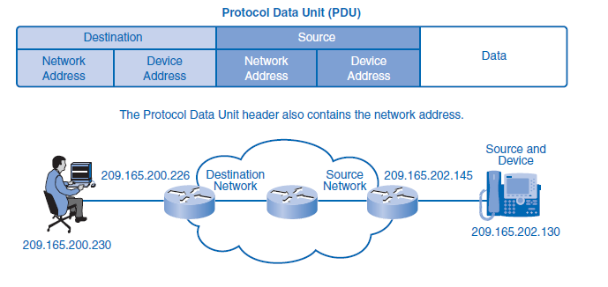
6. Network Addressing
Outline

Slide 40
6. Network Addressing
Outline
Getting Data to the Right Application
At Layer 4, information contained in the PDU header does not identify a destination host or a destination network. What it does identify is the specific process or service running on the destination host device that will act on the data being delivered.
Hosts, whether they are clients or servers on the Internet, can run multiple network applications simultaneously. People using PCs often have an e-mail client running at the same time as a web browser, an instant messaging program, some streaming media, and perhaps even a game. All these separately running programs are examples of individual processes.
The transport layer adds port numbers to its segment header information to ensure that the destination host knows which application process is to receive the packet.
The end host assigns a port number to each type of traffic going in and out. A user can send and receive many types of traffic over a single network interface, and using port numbers for each segment keeps traffic for web pages separate from e-mail traffic and so on. The segment contains both source and destination ports in case the receiver needs to contact the sender.

Slide 41
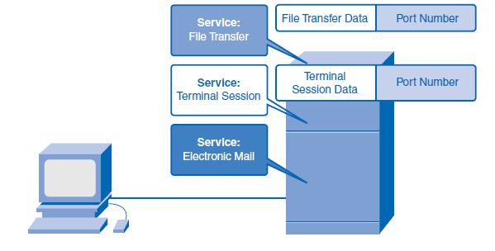
6. Network Addressing
Outline

Slide 42


THANK YOU

